Slide 1
Math Fluency Across the Grades
Core Advocates Monthly Webinar
June 7, 2017
The webinar will begin shortly. You may wish to download the handouts (check the tab on your webinar control panel) while you wait.
Notes:
Joanie

Slide 2
Introductions
Your hosts from the Field Impact Team
Sandra Alberti, Director
Jennie Beltramini, Teacher Engagement Manager
Janelle Fann, Project Manager
Joanie Funderburk, Manager of Professional Learning
Lynda Nguyen, Team Coordinator
This Month’s Guests
Kristi Gettelman, Core Advocate - WI
Ben Metcalf, Core Advocate - AZ
Notes:
Joanie

Slide 3
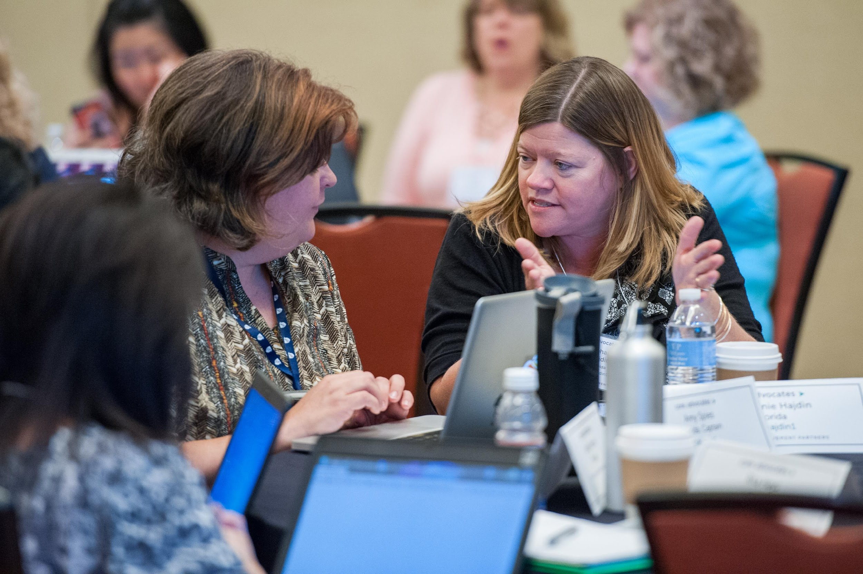
Who are Core Advocates?
Core Advocates are educators who:
  Believe in the potential of the CCSS to prepare all students for college and careers;
  Are eager to support their colleagues and communities in understanding and advocating for the CCSS and CCSS-aligned instruction;
  Understand and embrace the shifts in instruction and assessment required by the CCSS
Notes:
Joanie
The webinar was born to extend and support the Core Advocates program, and the chance to help teachers implement changes in their classrooms – give very brief info on CA here

Slide 4

To learn more about Core Advocates…
Contact Jennie Beltramini (jbeltramini@studentsachieve.net ) or Joanie Funderburk (jfunderburk@studentsachieve.net)
Complete this survey to join our database (and mailing lists): http://bitly.com/joincoreadvocates
Visit our website: www.achievethecore.org
Notes:
Joanie

Slide 5

For Tweeters…
Please feel free to tweet during and after the webinar using #coreadvocates
@achievethecore
@JoanieFun, @salberti, @JennieBeltro, @bgmet, @kgettelman
Notes:
JOANIE

Slide 6
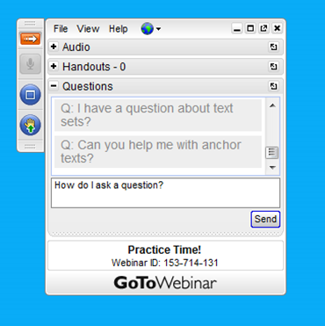
Webinar protocols
During the webinar
– Accessing Documents
– Questions option
– Polling
After the webinar
– Survey
– Access to recorded webinar
Notes:
JOANIE

Slide 7
Instructional Advocacy – A Definition
Grounded in a firm understanding of the Shifts, educators owning, supporting, and promoting the resources, tools, and practices that create learning environments in which students develop college- and career- readiness.

Slide 8
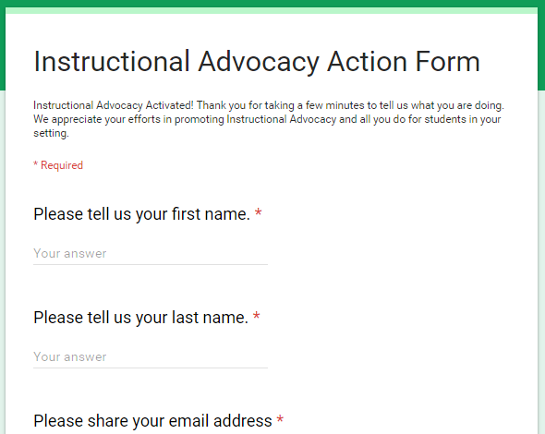
Tell us about your efforts
www.achievethecore.org/educators-taking-action

Slide 9
Goals of the webinar
Understand the importance of procedural skill and fluency in students’ mathematical experiences
Consider instructional strategies for building fluency across the grade levels
Learn about resources that support fluency
Notes:
JOANIE

Slide 10
What role does procedural skill and fluency play in students’ mathematics experiences?
Notes:
Joanie

Slide 11



The Shifts in Mathematics
Focus: Focus strongly where the Standards focus.
Coherence: Think across grades, and link to major topics within grades.
Rigor: In major topics, pursue conceptual understanding, procedural skill and fluency, and application.

Slide 12
Why focus on fluency?
"Math fact fluency leads to higher order mathematics.
Through automaticity students free up their working memory and can devote it to problem solving and learning new concepts and skills .” (Geary, 1994)
Geary, D. C. (1994). Children's mathematical development: Research and practical applications. Washington, DC: American Psychological Association.
Notes:
Developing students' computational fluency extends far beyond having student memorize facts or a series of steps unconnected to understanding. A rush to fluency, however, undermines students' confidence and interest in mathematics and is considered a cause of mathematical anxiety.

Slide 13
“To prepare students for Algebra, the curriculum must simultaneously develop conceptual understanding, computational fluency, and problem-solving skills. Debates regarding the relative importance of these aspects of mathematical knowledge are misguided. These capabilities are mutually supportive, each facilitating learning of the others. Teachers should emphasize these interrelations; taken together, conceptual understanding of mathematical operations, fluent execution of procedures, and fast access to number combinations jointly support effective and efficient problem solving.”
-National Mathematics Advisory Panel, 2008

Slide 14
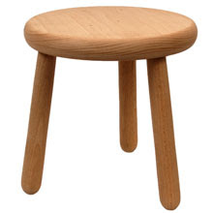
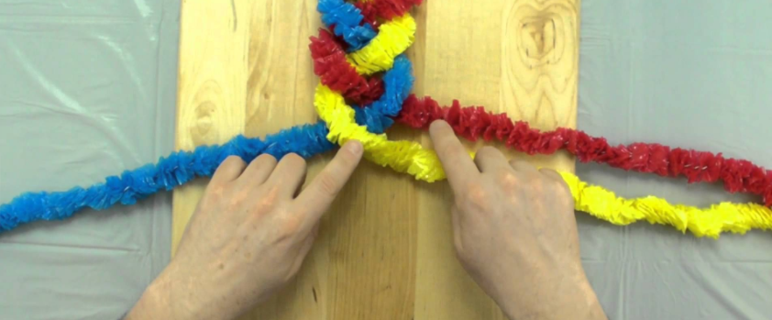
Connecting the aspects of rigor

Slide 15
Required Fluencies in K-6
Grade | Standard | Required Fluency
K | K.OA.5 | Add/subtract within 5
1 | 1.OA.6 | Add/subtract within 10
2 | 2.OA.2 2.NBT.5 | Add/subtract within 20 (know single-digit sums from memory) Add/subtract within 100
3 | 3.OA.7 3.NBT.2 | Multiply/divide within 100 (know single-digit products from memory) Add/subtract within 1000
4 | 4.NBT.4 | Add/subtract within 1,000,000
5 | 5.NBT.5 | Multi-digit multiplication
6 | 6.NS.2&3 | Multi-digit division Multi-digit decimal operations

Slide 16
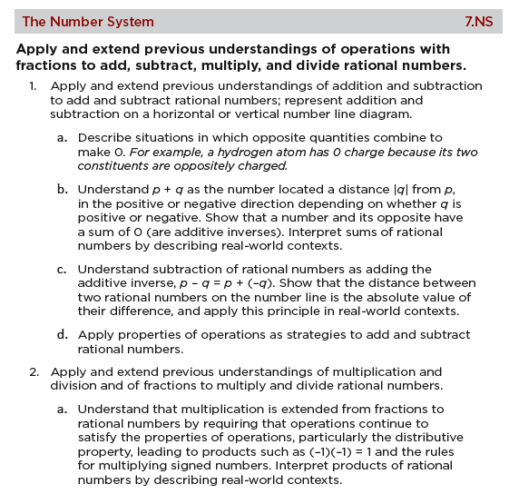
Procedural skill and fluency in middle school

Slide 17
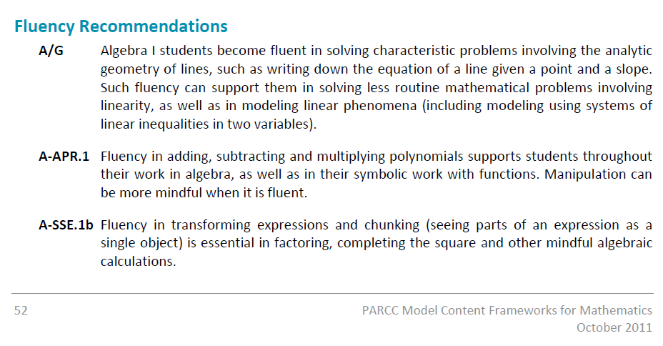
Procedural skill and fluency in high school

Slide 18
Question:
How have you seen fluency support the other aspects of Rigor (conceptual understanding and application) with your students?
Please use the Questions tab on your control panel to respond.

Slide 19
How can teachers support and build students’ fluency in mathematics?

Slide 20
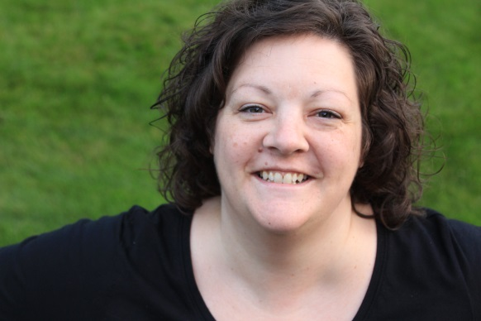
Guest Core Advocate
Kristi Gettelman
District Mathematics Leader
@KGettelman
please enter a headsthot here
Notes:
I support math instruction at the district level, working with teachers and students in Grades PreK-8.
Math Coach for 3 years in K-5 building
Classroom teacher for 17 years

Slide 21
NCTM’s Principles to Actions: Build procedural fluency from conceptual understanding
Research supports the importance of an integrated and balanced development of concepts and procedures in learning mathematics (National Math Advisory Panel, 2008; National Research Council, 2001).
“When procedures are connected with the underlying concepts, students have better retention of the procedures and are more able to apply them in new situations. (Fuson, Kalchman and Bransford, 2005)”
- Principles to Actions p. 42
Notes:
Principles to Actions describes and illustrates a set of 8 research-based teaching practices that support the mathematics learning of ALL students. One of these 8 practices is: Build procedural fluency from conceptual understanding.
A colleague in Milwaukee--“Never has there been a more important conjunction.”
Students become fluent with facts and procedures as a result of understanding strategies and concepts--this is built in to the Standards--COHERENCE.
When students make sense of facts/procedures they’re working on, they remember them better.

Slide 22
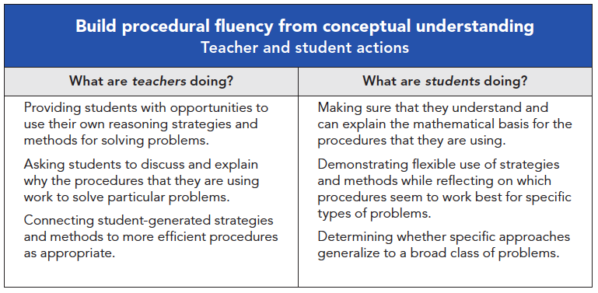
NCTM’s Principles to Actions
-Principles to Actions, p. 47
Notes:
Key word is “doing” -
Teachers are intentional in planning and instruction; provide opportunities for students to make sense of procedures before emphasizing formal steps or efficiency
Students are active learners, rather than passive participants; constantly making sense of concepts and strategies

Slide 23

Fluency is an Endpoint
Purposeful
Instruction
Consistent Practice
Opportunities
Balanced
Assessment
Notes:
Fluency doesn’t just “happen” - it’s a result of a carefully planned cycle of learning, with all components working together (like gears) to generate a successful end result.

Slide 24

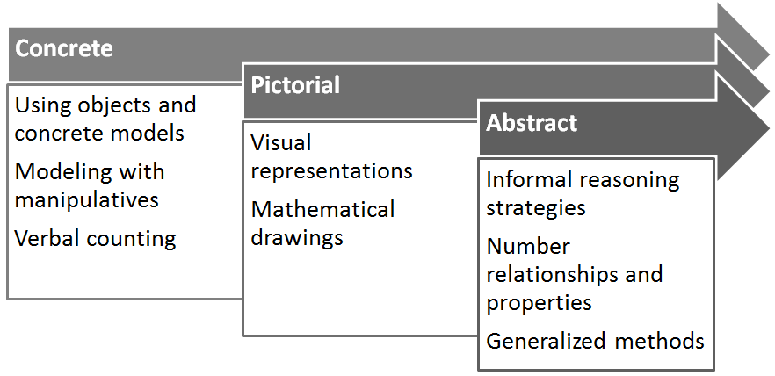
Purposeful Instruction
Build meaning
Target a specific concept/strategy/fact
Follow a developmental progression:
Notes:
Teachers need to be intentional in planning instruction that first builds understanding. Instruction should allow students to:
build meaning/understanding of concepts
explore multiple representations
As with most learning, students generally follow a developmental progression, moving from concrete models and strategies to more representational and abstract/symbolic thinking.
elem example: K.OA.A.1 develops conceptual understanding of adding & subtracting, 1.OA.C.6 emphasizes fluency within 10
if students are learning how to use their doubles facts, they might begin exploring with manipulatives like linking cubes counters of ten-frames → move to drawing pictures of cubes/counters in ten frames → to writing equations with numbers
intermediate example: 5.NF.B.4 develops conceptual understanding of multiplying fractions, 7.NS.A.2 emphasizes fluency
if students are working on operations with fractions, they might begin with fraction tiles or fraction strips→ then move to pictorial models (area models or number line models) → before being ready for symbols and formal procedures

Slide 25
Content Examples
  K.OA.A.1: Represent addition and subtraction with objects, fingers, mental images, drawings, sounds (e.g., claps), acting out situations, verbal explanations, expressions, or equations
  1.OA.C.6: Add and subtract within 20, demonstrating fluency for addition and subtraction within 10…
  5.NF.B.4: Apply and extend previous understandings of multiplication to multiply a fraction or whole number by a fraction
  7.NS.A.2: Apply and extend previous understandings of multiplication and division and of fractions to multiply and divide rational numbers.
Notes:
As with most learning, students generally follow a developmental progression, moving from concrete models and strategies to more representational and abstract/symbolic thinking.
elem example: K.OA.A.1 develops conceptual understanding of adding & subtracting, 1.OA.C.6 emphasizes fluency within 10
if students are learning how to use their doubles facts, they might begin exploring with manipulatives like linking cubes counters of ten-frames → move to drawing pictures of cubes/counters in ten frames → to writing equations with numbers
intermediate example: 5.NF.B.4 develops conceptual understanding of multiplying fractions, 7.NS.A.2 emphasizes fluency
if students are working on operations with fractions, they might begin with fraction tiles or fraction strips→ then move to pictorial models (area models or number line models) → before being ready for symbols and formal procedures
*Include comments about how the progression (concrete, pictorial, abstract) may not all happen within a single grade; also the point of not skipping the concrete and pictorial in the older grades… it’s not accelerating to go right to abstract!!!

Slide 26
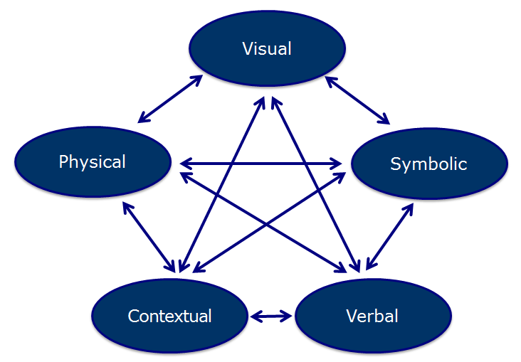
Use and Connect Multiple Representations
Notes:
NCTM identifies five different types of mathematical representations.
“The depth of student understanding is related to the strength of connections among mathematical representations that students have internalized.” (PtA, p. 25)
instruction should intentionally include use of all 5 representations
arrows indicate importance of making connections between and among representations

Slide 27
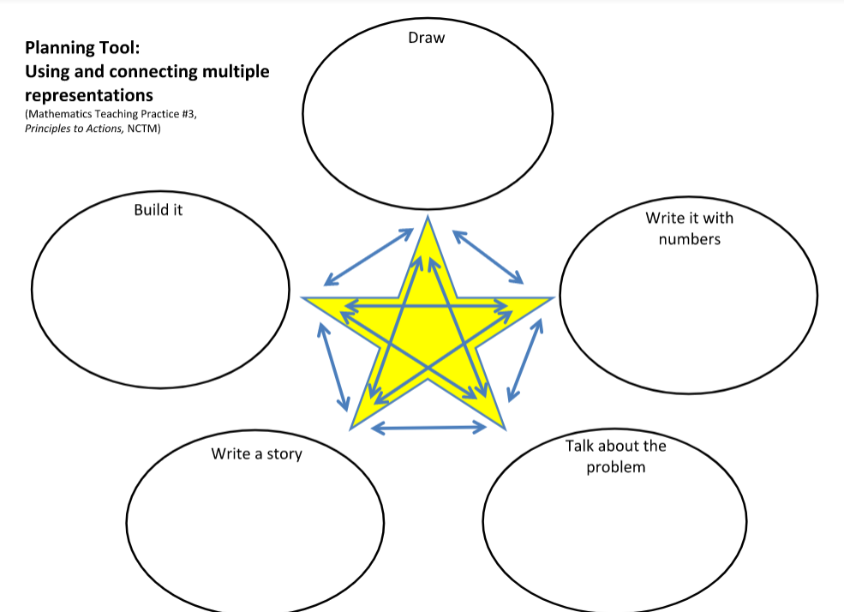
Notes:
We’ve included this planning tool as one of the handouts for this webinar - be purposeful about planning around using and connecting the different representations.
Think about your own instruction of the math concepts that contribute to fluency at your grade. Which of these is your instruction strong in? Which of these needs more attention in your instruction?

Slide 28
Pause and Reflect: Purposeful Instruction
Where in the Concrete->Pictorial->Abstract progression are the conceptual understanding and fluency standards for your grade?
How does using multiple representations support students’ building fluency?
Notes:
Take a moment to reflect on your own instruction...

Slide 29
Consistent Practice
“Do we give students the opportunity to think about what they know and understand and use it in ways that make sense to them?” (Gojak, 2012)
“If fluency is the goal, classroom instruction must emphasize the development and application of strategies.” (Kling, 2011)
Notes:
Sometimes practice is overlooked--teachers move from initial instruction to assessment, with few opportunities for students to engage in meaningful practice.

Slide 30
Consistent Practice
exercise repeated reasoning
build automaticity
What practice opportunities can teachers structure for students?
Number Talks
Hands-on/Minds-on Games
Strategically selected flash cards
Targeted activity sheets
Notes:
“When students learn to represent, discuss, and make connections among mathematical ideas in multiple forms, they demonstrate deeper mathematical understanding and enhanced problem-solving abilities.” (PtA, p. 24)
“understanding is deepened through discussion of similarities among representations” (Zimba, PtA, p. 26)
rather than memorizing, students are building automaticity as a result of repetition and experience

Slide 31
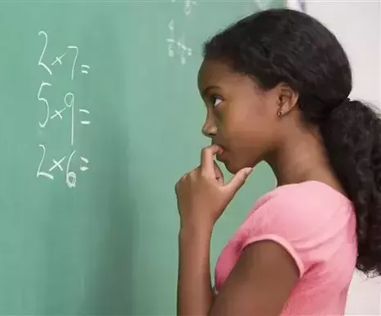

Deliberate practice vs “Drill and kill”
deliberate selection of problems
distributed over time, rather than in a single sitting
Notes:
Deliberate selection of problems that build on students’ knowledge/understanding/skills, not 50 of the exact same type of problem. “Students should be spending most of their time on the [facts/procedures] they do not know yet or on those they know but are not fast on yet”
distributed over time, rather than in a single sitting
Most drill uses many problems students know and thus is a big time waster

Slide 32
Pause and Reflect: Consistent Practice
How does your instruction provide for consistent practice?
Is practice time for your students meaningful in the ways described here?
How could you improve the consistent practice experiences of your students to support their fluency?

Slide 33
Balanced Assessment
“… by using different ways to assess children, we gain a more comprehensive, accurate picture of what they know, what they do not know, and their misconceptions.”
(Kling, Bay-Williams, 2014)

Slide 34
Compare to Reading…
Think about how you assess a student’s reading ability:
  Do you time students to see how many words they can read correctly in a specified amount of time?
  Do you listen and observe as they read?
  Do you ask questions to see if they understand what they’re reading?
Notes:
Think about how we measure a student’s reading ability--
we time them to measure their speed
we listen for cadence, expression, and accuracy
we ask questions to check for understanding

Slide 35
Compare to Reading…
Imagine only using timed tests to assess reading ability…
  Do you time students to see how many words they can read correctly in a specified amount of time?
  Do you listen and observe as they read?
  Do you ask questions to see if they understand what they’re reading?
Would you still be confident in your assessment?
Notes:
Now imagine if we only timed students to see how many words they can read in a couple of minutes… not really a full picture of a child’s reading ability. Math assessment should be viewed in the same way...

Slide 36
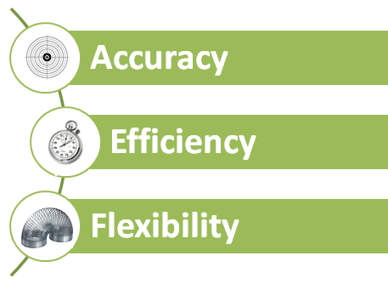
Components of Fluency
Notes:
3 components of fluency--assessment generally focuses on accuracy and efficiency, but little attention is paid to flexibility. A balanced system of assessment will give Ts information about all 3 aspects.

Slide 37
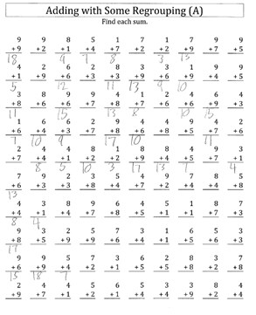
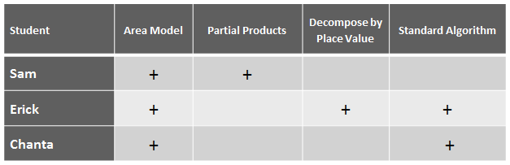
Balanced Assessment
Notes:
(notes for both slides 33-34)
If we think of fluency as accuracy, efficiency, and flexibility, then we need to find ways to collect evidence around these components--
timed tests only give us information about accuracy and speed, not flexible thinking
observations can be used like a running record in reading, to jot down on-the-spot information and inform next instructional steps
journal prompts and interviews can give us more insight into student thinking, and see how flexible a student’s thinking might be

Slide 38
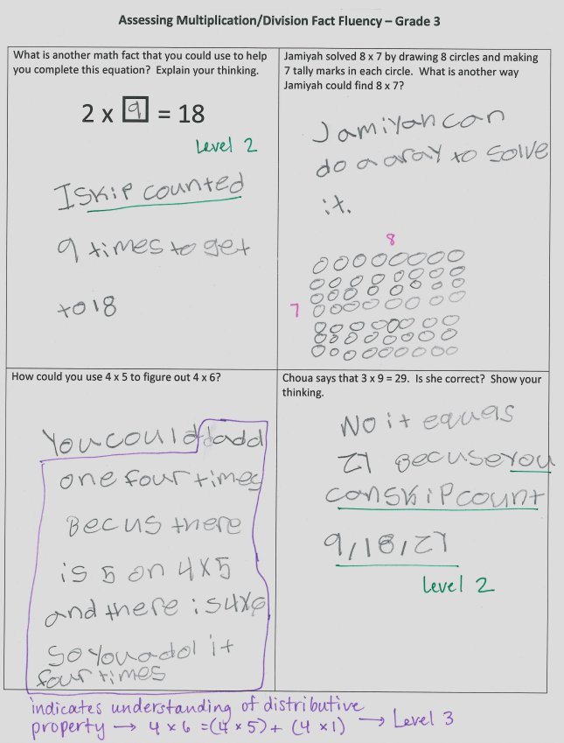
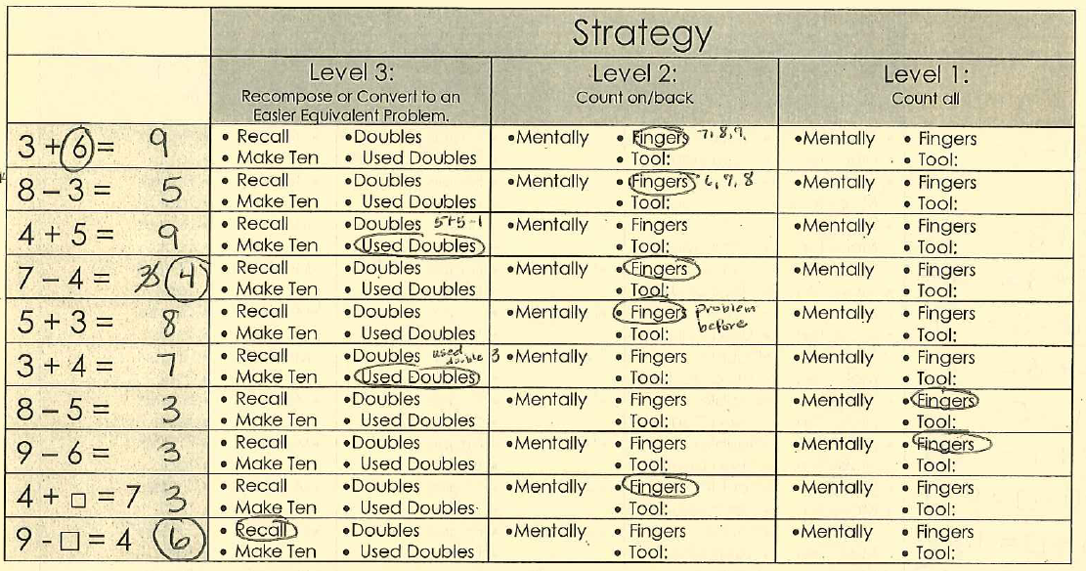
Balanced Assessment
Notes:
(notes for both slides 33-34)
If we think of fluency as accuracy, efficiency, and flexibility, then we need to find ways to collect evidence around these components--
timed tests only give us information about accuracy and speed, not flexible thinking
observations can be used like a running record in reading, to jot down on-the-spot information and inform next instructional steps
journal prompts and interviews can give us more insight into student thinking, and see how flexible a student’s thinking might be

Slide 39
Pause and Reflect: Balanced Assessment
What changes would you make to your formal and informal assessment of fluency practices?
How could you learn more about your students’ progress toward the required procedural skills and fluencies of your grade level?

Slide 40
Poll:
Which of the three aspects mentioned (Purposeful Instruction, Consistent Practice, Balanced Assessment) would you like to explore further?

Slide 41
Where can teachers find resources to support students’ fluency in mathematics?

Slide 42

Guest Core Advocate
Ben Metcalf
District Math Coach

Slide 43
Adapting Materials for Fluency
Performance Objectives → Standards
Standards Verbiage vs. Lessons to Support
Grade Level Focus vs. Attention in Materials
Supports Shifts - building fluency from conceptual understanding
Notes:
P.O. to standards: moving from incremental steps measuring discrete skills and knowledge with limited cognitive demand to standards that have a clear progression, with a range in cognitive demand.
Now three full years into K-8 adoption of CMP3 and INV 2 - contain a lot of great math; elicit problem solving, reasoning, and sense making; these were selected as tools that were identified to help shift some emphasis to sense making.
The premise is that fluency is an outcome of both thoughtful learning and deliberate practice. Investigations, especially, has many games that support fluency, but they have been challenging for many teachers to monitor and use to inform instruction. Overtime, students are developing a range of strategies, but not always with purpose or understanding. Deficits in fluency have snowballed as student progressed through the grades.
Beginning our process of adapting materials and merging resources into a guidance document similar to the GO Math! resource, to be more aligned to standards and their intent; including guidance on the type of instruction and level of abstraction within the lesson to provide a more aligned singular instructional resource.
The process is focused on removing non-grade level content and being more attentive to the intent of the standards - even if it means taking out some really fun and meaningful mathematics.

Slide 44
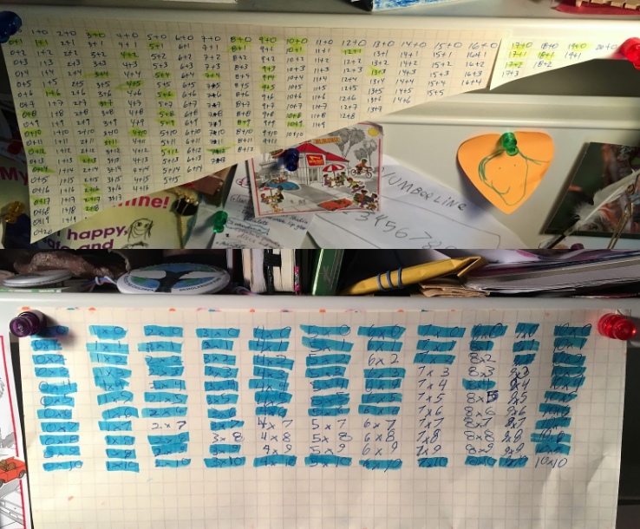
Using flashcards
Organizing practice so that it focuses most heavily on understood but not yet fluent products and unknown factors can speed learning.
Using Flashcards in Math
by Jason Zimba
Notes:
-Zimba blog post from last February.
Strategies to try to make practice enjoyable, distribute the work over time in short-segments, and encourage students to self-monitor and have an awareness of what they know “lickety-split” and the “toughies” they need to work on.
The picture shows some of the ways to help learners visualize their progress and identify some connections between the facts.
There are a lot of great resources and discussion happening about fluency.
-Elementary and Middle School Mathematics: Teaching Developmentally by John A. Van de Walle, Karen S. Karp, and Jennifer M. BayWilliams (Chapter 10)
Possible talking points:
In any case, here’s how I’ve tried to accomplish something similar using old-fashioned flashcards. I make no claim that my method is the best, or even better than others! But it has worked for us, and it’s been fun.
Here’s how it works:
The flashcards are kept in a “piggy-bank” made from an old tissue box.
We work at the dining table. My wife or I will draw a flashcard from the bank and show it.
If the answer comes back “lickety-split,” then the card is set aside. Otherwise, the card goes back in the bank. If there is doubt, then the card goes back in the bank.
If the student is drawing a complete blank, then I prompt with a strategy, for example if the problem is 6×8 and the reaction is a blank stare, then I might prompt with “Do you know 5 × 8?” Then the student can say “Oh right, that’s 40, so 8 more is 48.” Of course, the card goes back in the bank, but it has been a good just-in-time learning opportunity.
Although initially the bank contains many already-known facts like 2 + 1 or 3 + 0, this is intentional in order that the early sessions will feature easy, known facts and establish a foundation of confidence as we embark on the process. The rapid progress on Day 1 creates excitement. Pretty soon, those easy known facts exit the system and the bank becomes nicely focused on the student’s individual horizon. Of course, this also means that the work is getting tougher over time, so I pay attention to motivation and emotions while we work.

Slide 45
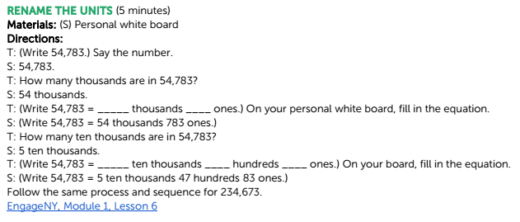
K-5 Resources for Centers, Games, Routines
RELEVANT STANDARD:
4.NBT.B.4 Fluently add and subtract multi-digit whole numbers using the standard algorithm.
GO Math! Guidance Documents
Notes:
These documents provide a set of short activities extracted from Engage NY and Illustrative Mathematics, two Open Education Resources. While initially created as a supplement to Go! Math, teachers who are using a variety of curricula have found these fluency resources helpful. The activities are designed to support students’ progress toward the grade-level numeracy and fluency articulated in the Standards. They are intentionally short, providing educators the flexibility to use them before or after a lesson or anytime during the school day. The activities are intended to be used throughout the school year.
Here is a sample from 4th grade. Notice how this activity supports the conceptual understanding of place value, which in the 4th grade standards serves to support students in building fluency with multi-digit addition and subtraction.

Slide 46
Middle and High School Fluency Builders
Combination of timed opportunities to see growth separated by opportunities for untimed practice to build understanding and refine strategies
Create opportunities for challenge for all students.
EngageNY Sprints
PARCC Mathematics Content Framework (3-11)
Notes:
Reflections from the Pilot
•The competitive nature of pre- and post-practice timed sprints motivates students to achieve personal bests.
•The practice problem sets lead to good discussions about strategies for different mathematical procedures.
•The volume of problems on some activities felt overwhelming to some students.
•Sixty seconds can feel too quick for sprints with more challenging problems (e.g., operations with different types of rational numbers).
•Some teachers noticed more careless errors on timed sprints compared to untimed practice.
No explicit skills defined for high school fluency, but student suc
The assessments used for the pilot were intentionally longer than could be completed in the allotted amount of time.
Untimed practice support starts with appreciation for building procedural fluency from conceptual understanding.
Resources to explore or start the discussion:
Faster Isn’t Smarter by Cathy L. Seeley
Elementary and Middle School Mathematics: Teaching Developmentally by John A. Van de Walle, Karen S. Karp, and Jennifer M. BayWilliams (Chapter 10)
Number Talks by Sherry Parrish
Developing Number Sense by Rusty Bresser and Caren Holtzman

Slide 47
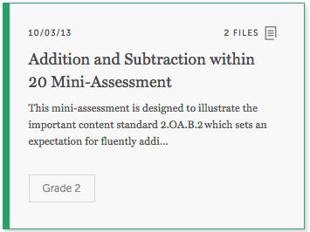
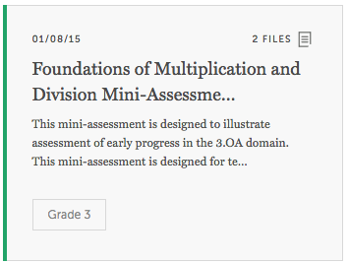
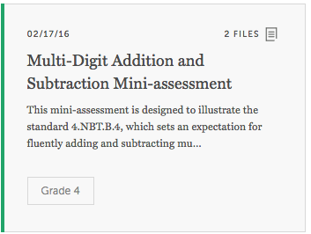
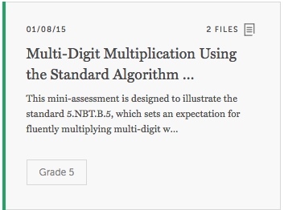
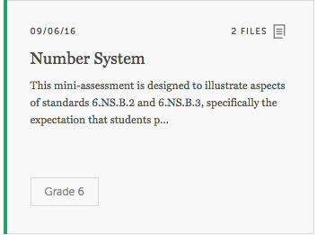
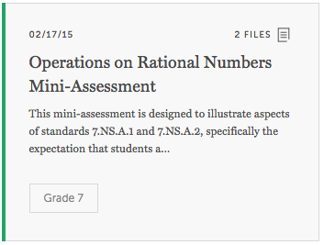
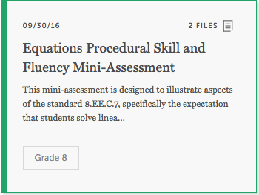
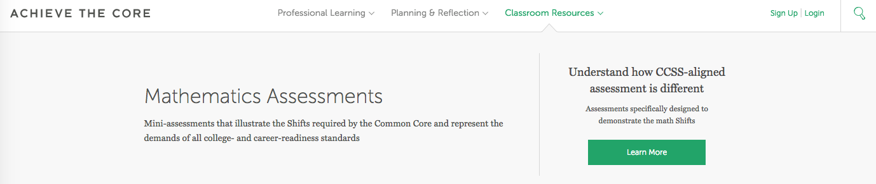
Mini-Assessments on Achieve the Core
Notes:
Three mini-assessments for grades second through eighth grade, and 1 high school quadratic equations assessment – many of the fluency standards are represented in the collection
Mix of focus on individual or blended aspects of rigor: fluency, application, and conceptual understanding
PDF or Word files that can be easily modified for altered reuse
Some have multiple sections and could require as much as 40 minutes; the fluency activities are much shorter.

Slide 48
Question:
Which of these resources would be most helpful to you and your students?
Please use the Questions tab on your control panel to respond.

Slide 49
Your Questions

Slide 50
Tell us about your efforts
www.achievethecore.org/educators-taking-action

Slide 51
Please join us again next month!
Next month’s webinar: What I use in my classroom
Wednesday, July 5 7:00 - 8:00 pm EDT
Register Here: https://attendee.gotowebinar.com/register/623126607851447553

Slide 52
Thank You!

Slide 53
Resources Mentioned on the Webinar
Achieve the Core fluency resources:
K-5 Routines and Centers
Jason Zimba’s blog on using flashcards
Math Mini-Assessments
Engage NY Sprints for grades 6-8
Books
NCTM’s Principles to Actions
Number Talks K-5, Fractions-Decimals-Percentages, Making Number Talks Matter
Elementary and Middle School Mathematics: Teaching Developmentally

